Slide 1
Helpful Human Interview Challenge
By Curtis Yungen
August 2019

Slide 2
Core Goals
Replicate design
Font
Styles
Iconography
Replicate functionality
Create a database of colors (minimum 100)
Paginate your data to show a certain number of swatches at a time
Display both the color swatch and the label of the color
Ability to select random color and modify view accordingly
Clicking swatch changes to color detail view

Slide 3
Stretch Goals
Design
Make it responsive
Functionality
Generate color list from a script
Bonus Stretch Goals
Design
Include interaction design
Add tints/shades in detail view
Functionality
Add search functionality
Color generation script guarantees same colors and order
Group by color (Make sidebar menu functional)
Data
Fetch data with GraphQL

Slide 4
Deliverables
In your email submission response to the test invitation from AngelList, please include the following:
Link to your repo
URL to your hosted App (Use a free hosting service of your choice)
Include a Donger that best represents your state of mind when complete

Slide 5
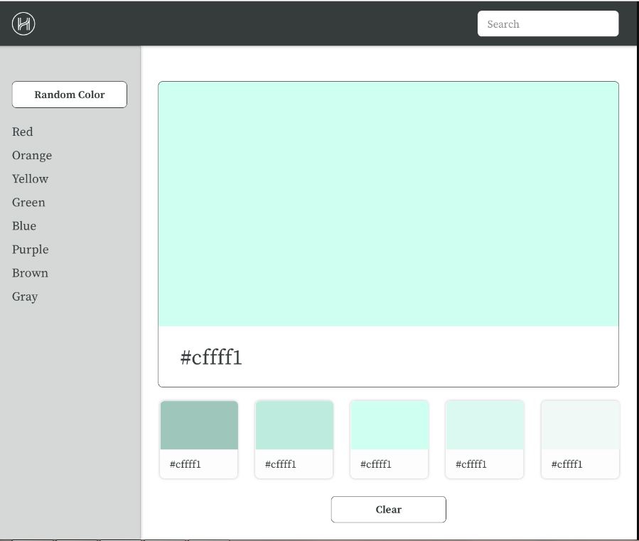

Slide 6
Navbar
Tools
Node.js
Express.js
ReactJS
Bootstrap
Components
Navbar
Sidebar
Color
Suggestions
Option
Sidebar
Color
Suggestions
Option

